Slide 1


Dijkstra's Algorithm
By Jacob Pelletier
Southern Connecticut State University
CSC 505

Slide 2
Background: 1. Who was Dijkstra? 2. Why would one implement Dijkstra's? 3. Assumptions: when would one use Dijkstra's?

Slide 3
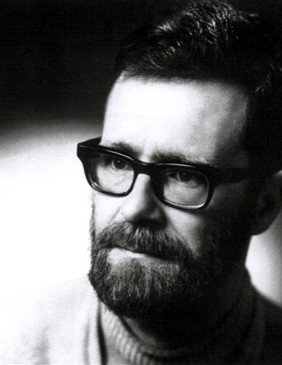
1. Who is Dijkstra?
Edsger Dijkstra (DYKE- stra) (2)
Dutch computer scientist, 1930-2002 (2)
Won Turing award 1972 (2)
Instrumental in the development of structured programming (2)
Using if/else/then loops, while/for, etc

Slide 4

2. Why would one use Dijkstra?
Dijkstra's algorithm is used to calculate the shortest path between two points from a single source (2)
For example,
This could be in the form of navigating streets
Routing through a network
Flight planning

Slide 5
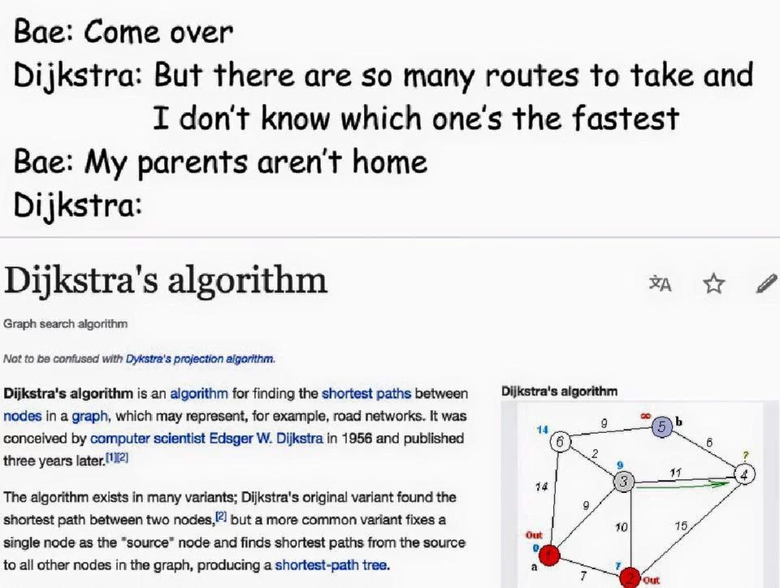

Slide 6
3. Assumptions: when would one use Dijkstra's?
Weighted graph may be directed or undirected
Weighted graph vertices must be connected
Edges (or vertices) must have nonnegative weights
Otherwise, it will loop forever if sum of all weights is less than zero (2)
It would confuse min-priority que (as we will see later)

Slide 7


Slide 8
This is a graph. Graphs are made up from nodes (vertices) and edges.
Nodes
Edges

Slide 9
Graphs can be directed or undirected.
Dijkstra can be used on directed or undirected graphs.
This graph is undirected:

Slide 10
Graphs can be directed or undirected.
This graph is directed:

Slide 11
This is a weighted graph. This means that with each edge between 2 nodes there is an associated "cost" or "weight" of traveling between those nodes:
2
7
3
4
9

Slide 12
In order to use Dijkstra's, all edge values must be positive.
2
7
3
4
9

Slide 13
This is an undirected, weighted graph
2
7
3
4
9

Slide 14
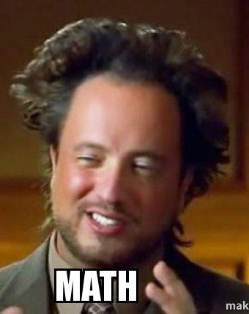
An Introduction to Dijkstra's Algorithm (What is Dijkstra's?): 1. General approach of the algorithm 2. Requirements to implement the algorithm

Slide 15
Generally, How Does It Work?
Choose a starting-point (source node) and an end-point. At this moment, there is a list of visited vertices and a list of not-yet-visited vertices.
We will then choose the next closest vertex not yet examined, we will add this vertex to the list of visited vertices, and continue in this manner until we reach the end-point.
We don’t pre-suppose the weight of any given node, so at the start the weights are of all nodes are infinity
Therefore, Dijkstra's can be said to be a greedy strategy algorithm, as it will always choose the shortest path between the current node and the next node.
Travels through the weighted graph similar to Breadth-first search algorithm
l (5)

Slide 16

NOTES ON ALGORITHMS....
What is a greedy algorithm?
In short, it is an algorithm that makes the best choice in the moment.
"It makes a locally optimal choice in the hope that this choice leads to the globally optimal solution."(1)
Greedy strategies do not always yield the optimal results, but Dijkstra's will compute the shortest path
(2)

Slide 17
What does a breadth-first search do?
One of the simplest ways to navigate a weighted graph (1)
It states that given a graph that we will call G, (G=(V,E)) we have a source called s
From s, it reaches out all vertices (v) connected to s, and these newly discovered v are added to an array of discovered v.
It is called breadth-first beacause it reaches out to all unknown vertices uniformally (eg will discover all v at distance k from s before discovering distance k+1 from s.
(2)

Slide 18
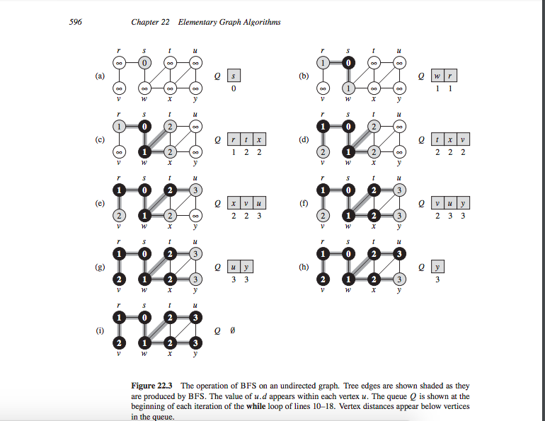
(2)

Slide 19
BFS vs DIJKSTRA?
BFS assumes all costs are equal
DIJKSTRA makes no such assumption
If all costs are, in fact equal, there then BFS == DIJKSTRA!
So, what is special about Dijkstra's algorithm?
(2)

Slide 20
Implementing Dijkstra's Algorithm (How does one Dijkstra?): 1. The basic algorithm 2. Dijkstra's implementation in Python

Slide 21

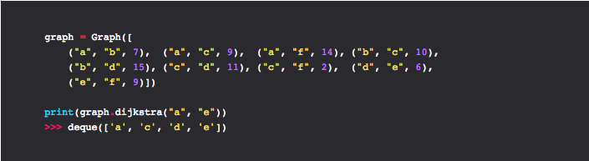

Slide 22
The Algorithm in python pseudocode:
1. INITIALIZE-SINGLE-SOURCE (G, s)
2. S = [];
3. Q = G.V
4. while Q != {}:
5. u = EXTRACT-MIN{Q}
6. S = S union {u}
7. for each vertex v G.Adj[u]
8 RELAX(u,v,w)
(2)
1. (start with graph G, and a single source)
2. (a set of S verices whose shortest path is determined)
3. (min priority que, Q = V – S at the beginning of each while loop- the que containing all vericies)
4. (while the min-priority que is not empty)
5. (vertex u and it associated weight in Q with minimum distance)
6. (add u to list of shortest paths)
7. (for each vertex where v is an element of a set of adjacent )
8 (relaxation means that after each loop, the shortest path bewtwen s (the source) and u will be kept track of. The shortest distance between s and all discovered vertices are kept track of)
(3)

Slide 23
What is a min-priority que?
A priority queue come as either min-priority or max-priority.
How exactly does Dijkstra maintain a set (S) of elements and keys (vertices and lengths)
In a min-priority queue, the initial step will have the minimum weight (s=0), and each additional step will be must greater than the prior (In a dijkstra implementation for example, the distance as you travel through the graph increases as you choose the shortest distance at each step).
(2)

Slide 24
What does a does "edge relaxation" really mean?
The shortest path between a source (s) and some vertex (v) is found by replacing the current path with the current shortest distance.
Edge relaxtion is done between each node and newly discovered node exactly once, and if the distance is shorter the value of the current distance, the distance is updated.
It is called edge relaxation because in the beginning, all distances from s are assumed to be infinity. Imagine a string that is fully extended. As each new shortest path is discovered, the string is incrementally relaxed until it reaches its most relaxed state.
(4)

Slide 25
Dijkstra implementation in Python
Information from the following slides are from:
Implementation from dev.to
Dijkstra's algorithm in python: algorithms for beginners by Maria Boldyreva
https://dev.to/mxl/dijkstras-algorithm-in-python-algorithms-for-beginners-dkc

Slide 26
Rosetta Code implementation:
"
Mark all nodes unvisited and store them.
Set the distance to zero for our initial node and to infinity for other nodes.
Select the unvisited node with the smallest distance, it's current node now.
Find unvisited neighbors for the current node and calculate their distances through the current node. Compare the newly calculated distance to the assigned and save the smaller one. For example, if the node A has a distance of 6, and the A-B edge has length 2, then the distance to B through A will be 6 + 2 = 8. If B was previously marked with a distance greater than 8 then change it to 8.
Mark the current node as visited and remove it from the unvisited set.
Stop, if the destination node has been visited (when planning a route between two specific nodes) or if the smallest distance among the unvisited nodes is infinity. If not, repeat steps 3-6.
"

Slide 27
Import data and data formats
(Namedtuple for storing edge data)
A class is used to initialize objects (edges/nodes)
Initialize data
Find vertices
Include add and remove edge functionality
Find neighbors for nodes
A function is used to define Dijkstra's
1. the algorithm
1. create a graph and implement

Slide 28
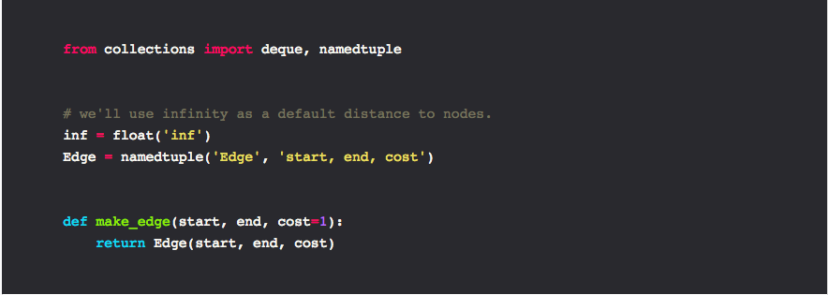

Slide 29
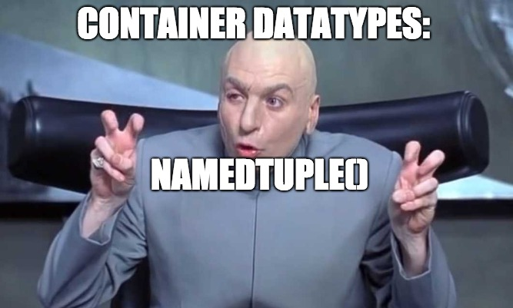

Slide 30
namedtuple() from python3 docs
collections.namedtuple(typename, field_names)
In this implementation. . .
Edge = namedtuple("Edge", "start, end, cost")

Slide 31
collections.namedtuple(typename, field_names)
In this implementation. . .
Edge = namedtuple("Edge", "start, end, cost")

Slide 32
Import data and data formats
(Namedtuple for storing edge data)
Initialize data
Find vertices
Include add and remove edge functionality
Find neighbors for nodes
1. the algorithm
1. create a graph and implement

Slide 33
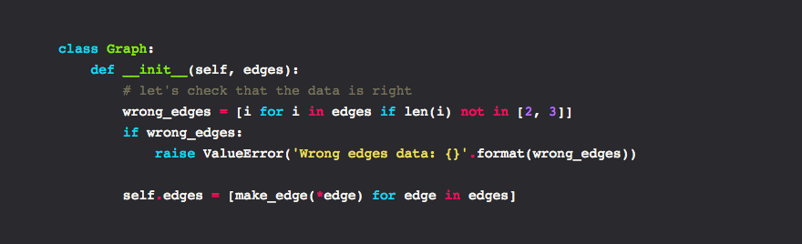

Slide 34
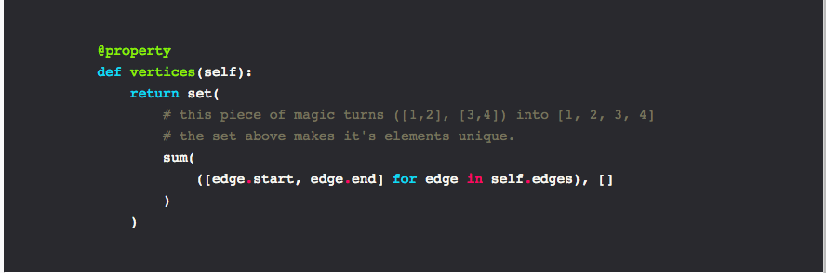

Slide 35


Slide 36
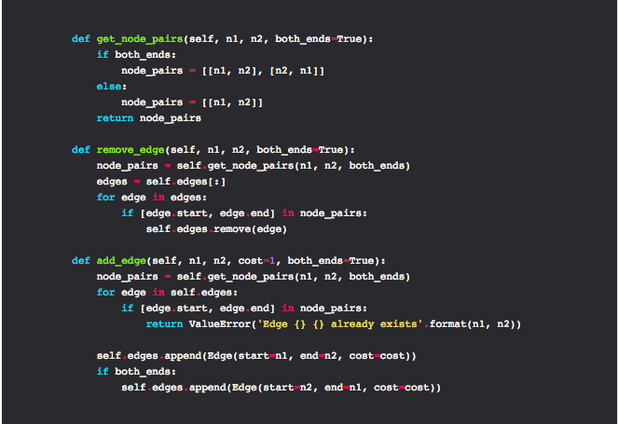

Slide 37
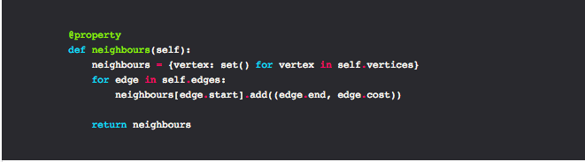

Slide 38
Import data and data formats
(Namedtuple for storing edge data)
Initialize data
Find vertices
Include add and remove edge functionality
Find neighbors for nodes
1. the algorithm
1. create a graph and implement

Slide 39
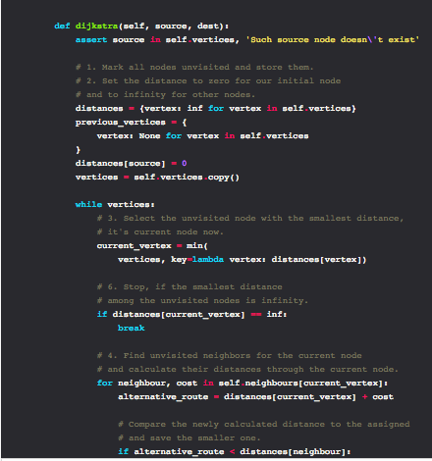
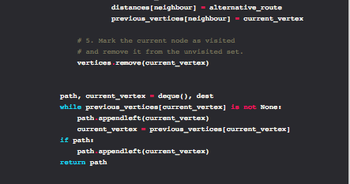

Slide 40
Import data and data formats
(Namedtuple for storing edge data)
Initialize data
Find vertices
Include add and remove edge functionality
Find neighbors for nodes
1. the algorithm
1. create a graph and implement

Slide 43
Citations 1) Britannica, The Editors of Encyclopaedia. “Edsger Dijkstra.” Encyclopædia Britannica, Encyclopædia Britannica, Inc., 2 Aug. 2018, www.britannica.com/biography/Edsger-Dijkstra. 2) Cormen, T., Leiserson, C., Rivest, R., Stein, C. (2009). Introduction to Algorithms. Cambridge, Mass: MIT press. 3) Faria, Al, Valente, M., Gupta, U., Saliu, V. (2015) Dijkstra's Shortest Path in Hardware. Columbia University. http://www.cs.columbia.edu/~sedwards/classes/2015/4840/reports/Labyrinth.pdf 4) Larmore, L., CSC269 Lecture notes. University of Nevada, Las Vegas http://web.cs.unlv.edu/larmore/Courses/CSC269/pathing 5) Patel, A., (2018). Introduction to A*. Blog post from theory.stanford.edu http://theory.stanford.edu/~amitp/GameProgramming/AStarComparison.html

Slide 44

Questions

